Slide 1

INSTITUTE: UIE (AIT-CSE)
Computer Networks CST- 348
Lecture – 1.14 AND 1.15
Multiplex access protocols with random access protocols like ALOHA,CSMA,CSMA/CD
By : Dr. Monica Luthra(e9836)
DISCOVER . LEARN . EMPOWER

Slide 2

Course Objectives
CO Number | Title
CO1 | Describe the important networking concepts
CO2 | Understand concept of network reference models and protocols
CO3 | Apply the concepts of routing algorithms on various networks
CO4 | Identify mechanism to handle traffic and control on congestion
CO5 | Identify and understand connection establishment techniques and features

Slide 3

Course Outcomes
After this course student will be able to:
To bring together several key of Computer network design and architecture
To Familiarize the student with the basic taxonomy and terminology of the computer networking area.
To Allow the student to gain expertise in some specific areas of networking such as the design and maintenance of individual networks.

Slide 4

Multiple Access Protocol
When a sender and receiver have a dedicated link to transmit data packets, the data link control is enough to handle the channel. Suppose there is no dedicated path to communicate or transfer the data between two devices.
For example, suppose that there is a classroom full of students. When a teacher asks a question, all the students (small channels) in the class start answering the question at the same time (transferring the data simultaneously). All the students respond at the same time due to which data is overlap or data lost. Therefore it is the responsibility of a teacher (multiple access protocol) to manage the students and make them one answer.
Image Source : https://www.grandmetric.com/2018/03/08/how-does-switch-work-2/

Slide 5
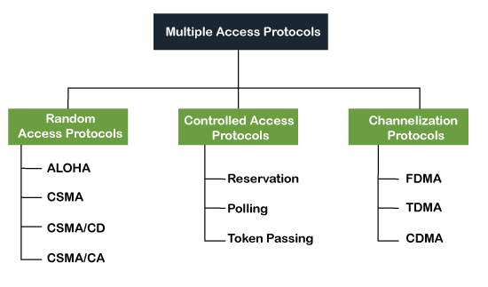
Types of multiple access protocol
Image Source : https://www.javatpoint.com/multiple-access-protocols/

Slide 6
Random-Access Protocols
Following are the different methods of random-access protocols for broadcasting frames on the channel.
Aloha
CSMA
CSMA/CD
CSMA/CA

Slide 7
ALOHA Random Access Protocol
It is designed for wireless LAN (Local Area Network) but can also be used in a shared medium to transmit data. Using this method, any station can transmit data across a network simultaneously when a data frameset is available for transmission.
Aloha Rules
Any station can transmit data to a channel at any time.
It does not require any carrier sensing.
Collision and data frames may be lost during the transmission of data through multiple stations.
Acknowledgment of the frames exists in Aloha. Hence, there is no collision detection.
It requires retransmission of data after some random amount of time

Slide 8
CSMA (Carrier Sense Multiple Access)
It is a carrier sense multiple access based on media access protocol to sense the traffic on a channel (idle or busy) before transmitting the data. It means that if the channel is idle, the station can send data to the channel. Otherwise, it must wait until the channel becomes idle. Hence, it reduces the chances of a collision on a transmission medium.

Slide 9
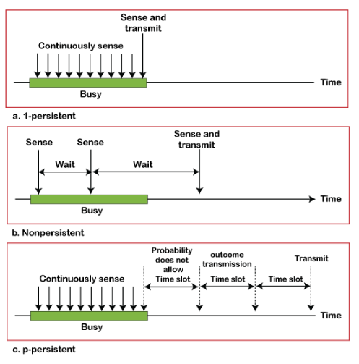
CSMA Access Modes
1-Persistent
Non-Persistent
P-Persistent
O- Persistent
Image Source : https://www.javatpoint.com/multiple-access-protocols/

Slide 10
CSMA/ CD
It is a carrier sense multiple access/ collision detection network protocol to transmit data frames.
The CSMA/CD protocol works with a medium access control layer. Therefore, it first senses the shared channel before broadcasting the frames, and if the channel is idle, it transmits a frame to check whether the transmission was successful.
If the frame is successfully received, the station sends another frame.
If any collision is detected in the CSMA/CD, the station sends a jam/ stop signal to the shared channel to terminate data transmission. After that, it waits for a random time before sending a frame to a channel.

Slide 11
CSMA/ CA
It is a carrier sense multiple access/collision avoidance network protocol for carrier transmission of data frames.
It is a protocol that works with a medium access control layer. When a data frame is sent to a channel, it receives an acknowledgment to check whether the channel is clear.
If the station receives only a single (own) acknowledgments, that means the data frame has been successfully transmitted to the receiver.
But if it gets two signals (its own and one more in which the collision of frames), a collision of the frame occurs in the shared channel. Detects the collision of the frame when a sender receives an acknowledgment signal.

Slide 12
Key Points
Any station can transmit data to a channel at any time.
It is a carrier sense multiple access/ collision detection network protocol to transmit data frames.
If the frame is successfully received, the station sends another frame.
If the station receives only a single (own) acknowledgments, that means the data frame has been successfully transmitted to the receiver

Slide 13
References
https://www.geeksforgeeks.org/basics-computer-networking/
https://www.youtube.com/watch?v=VwN91x5i25g&list=PLBlnK6fEyqRgMCUAG0XRw78UA8qnv6jEx
http://www.svecw.edu.in/Docs%5CCSECNLNotes2013.pdf
https://www.cloudflare.com/learning/ddos/glossary/open-systems-interconnection-model-osi/

Slide 14
THANK YOU
For queries
Email: monica.e9836@cumail.in

